Slide 1

Line encoding and decoding simulator
Presented to:-
Rusmita Halim Chaity
Lecturer, Dept. of CSE
Green University of Bangladesh
Presented by :-
Proshen Biswas Niloy (231002002)
Promod Chandra Das (231002005)
Dept. of CSE
Green University of Bangladesh

Slide 2
Contents
Introduction.
Objectives.
Tools And Technologies.
Implementation.
Future Scope of work.
Conclusion.
References.

Slide 3

Introduction
Line encoding and decoding is a technique used in digital communication systems to convert binary data into a physical signal for transmission over a medium. This signal representation ensures proper synchronization, error detection, and efficient use of bandwidth.

Slide 4

Objectives
To implement a console-based simulator using the C programming language.
To demonstrate the process of encoding and decoding binary data using various line coding techniques.
To help visualize how each encoding scheme transforms binary data into signal levels.
To enhance understanding of signal behavior in digital communication systems.
To provide a user-friendly interface for selecting encoding schemes and observing output in real-time.

Slide 5
Tools And Technologies
The Line Encoding Decoding Simulator was developed using the C programming language and additionally used MATLAB for visualization. The project was implemented in a console-based environment, making it compatible with popular development tools such as Code::Blocks, Dev-C++ or GCC on both Windows and Linux platforms. Standard C libraries like stdio.h, string.h, and stdlib.h were utilized to manage input/output operations, string manipulation and basic functions.

Slide 6
Implementation
Operation of the system:
Encode or Decode:
Select Scheme:
NRZ-L
NRZ-I
Manchester
Differential Manchester
AMI
Pseudo-Ternary
Exit.

Slide 7
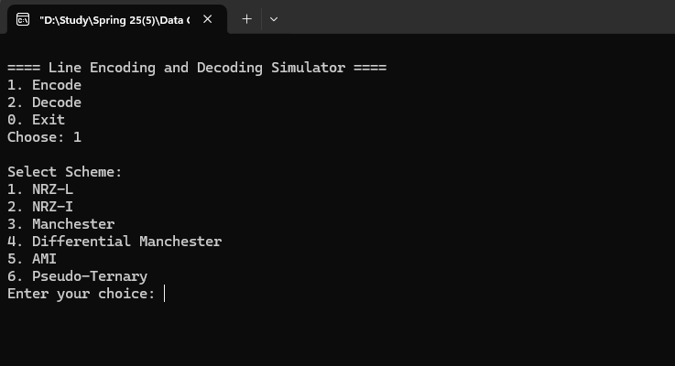
Output

Slide 8
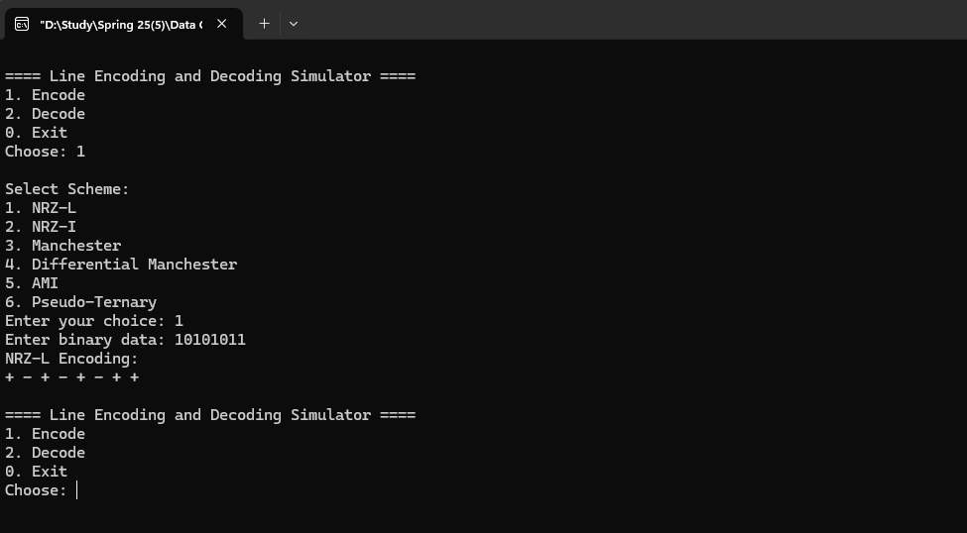
Output

Slide 9
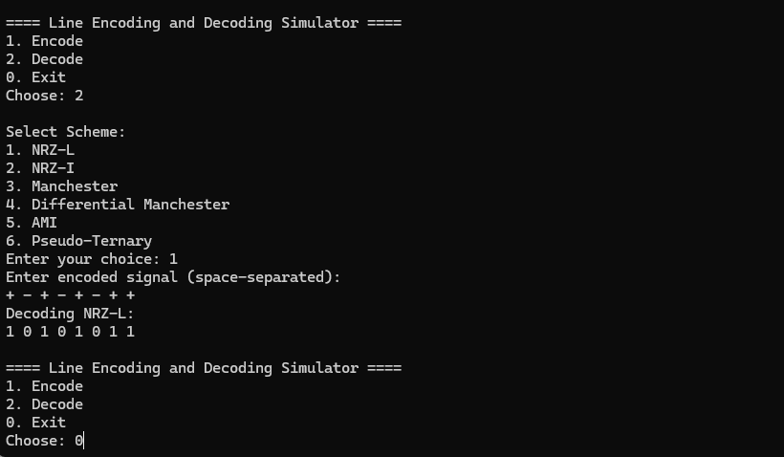
Output

Slide 10
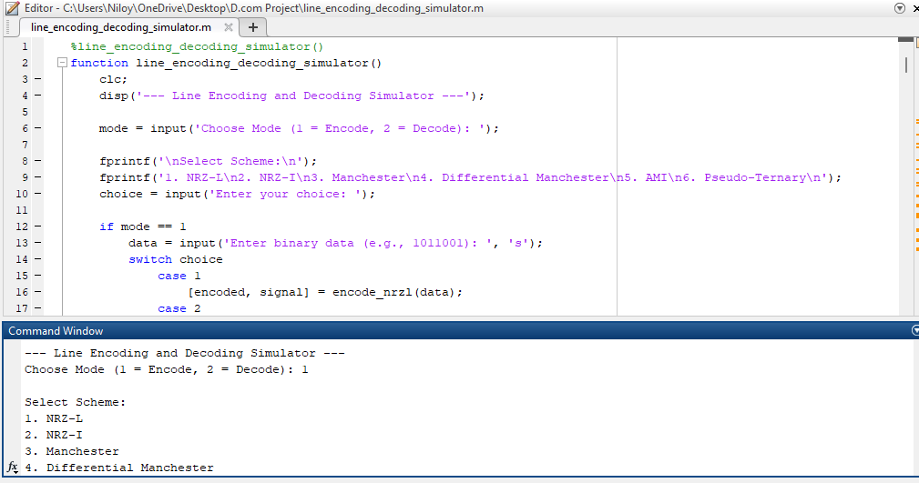
Output

Slide 11
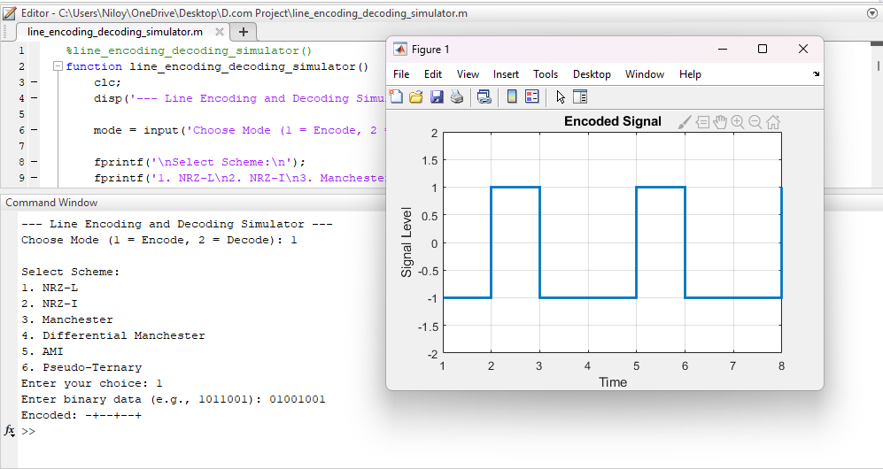
Output

Slide 12
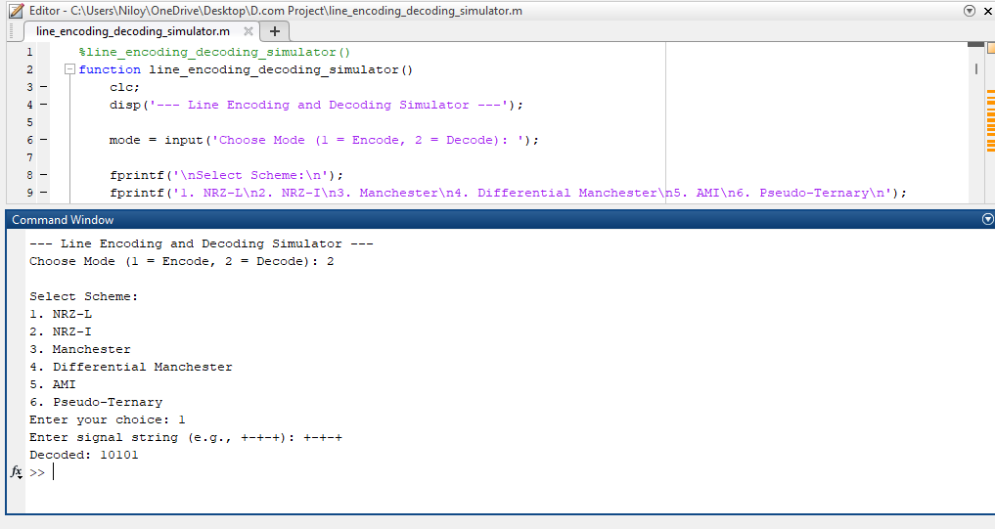
Output

Slide 13
Future Scope of work
In the future, the Line Encoding Decoding Simulator can be enhanced by adding a graphical user interface (GUI) for better usability and interaction. More encoding techniques like AMI, HDB3, and 4B/5B can be included to extend its capabilities. Features such as noise simulation and error detection can make it more realistic. Additionally, developing it as a web or mobile app would increase accessibility, and integrating it with hardware platforms could support real-time communication experiments.

Slide 14
Conclusion
The Line Encoding Decoding Simulator provides a practical approach to understanding how binary data is converted into signal formats for digital communication. By implementing various encoding schemes in C and using MATLAB for visualization, the project effectively demonstrates key concepts such as synchronization, signal representation, and bandwidth efficiency. It serves as a valuable educational tool and lays the foundation for future enhancements in both software and hardware integration.

Slide 15
Thanks for listening!

